Slide 2



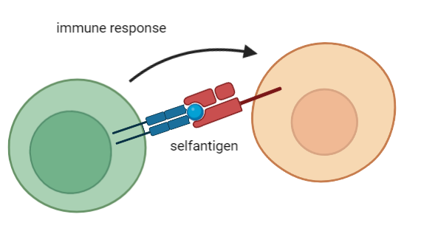
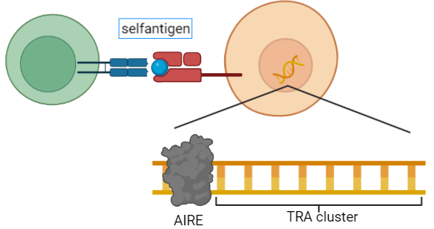


Biological background
1. Tissue restricted antigens (TRAs)
Genes for Self-antigens → essential for functional immune cells
Genes which are more than 5x than the median in less than 5 tissues expressed
Ordered in Autoimmune Regulator (AIRE) controlled cluster
Notes:
Two important key words: first is TRAs
Functional immune cells are necasssary to prevent infections
Shouldn’t react against selfantigens -> negative control in thymus
Medullary thymic epithelial cells (mTECs) present slef-antigens on their surface, reacting immune cell will be removed
Tissue restricted antigens (TRAs) code for selfantigens
Genes more than 5x the median in less than 5 diffrent tissues expressed
TRAs are ordered in cluster which are controlled by the transcriptionfactor Autoimmune Regulator (AIRE)

Slide 3
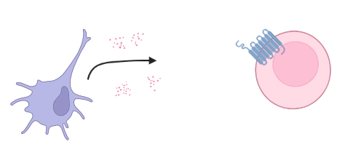
Biological background
2. Chemokines
Groupe of small similar proteins
chemoattractors
Bind to G-Protein coupled receptors (GPCR) → induce signaling cascade
Notes:
The second important key word is chemokine
Small groupe of proteins with similar structure
Chemoattractors: -> cells (dendritic cells) rerlease them, effector cells (leukocytes) move to the origin of release
->chemokines bind to GPCR and induce signaling cascade

Slide 4
Biological background
3. Biological thesis
Notes:
Functional immune cells are necasssary to prevent infections
Shouldn’t react against selfantigens -> negative control in thymus

Slide 5


Dataset

Slide 6

Milestones/Timeline

Slide 7

Team/Roles

